Slide 1


Fundamentals of RM
RM System and Process
Leadership in RM
Incident Investigation
RM Tools & Challenges
RM in Industry
People & Org.
Application and Perspectives
On Becoming a
Leader in Risk Management
ENGG404 - Lecture
Chapter 7.5: The Importance of Leadership and The Links Between Safety Performance, Culture, and the Role of Leadership in Shaping Culture

Slide 2
Learning Outcomes:
Explain and demonstrate the link between culture and safety performance, and how culture affects performance.
Explain and demonstrate the link between leadership actions and culture.
Explain how desirable behaviours and undesirable behaviours of the leader directly impact the culture of the organization.
Explain the concept of “high potential incidents”; explain how leaders can identify these “HiPo” incidents and use leading indicators to influence culture, and explain the rationale why leaders need to focus on these “HiPo” incidents.
Explain the DuPont-Bradley Curve and demonstrate how one can analyse an organization to determine its phase of development.
Explain the integration of The Fundamental Process of Management, RME #6 Program Evaluation and Continuous Improvement, and the DuPont-Bradley Curve.
Chapter 7.5: The Importance of Leadership and Links
‹#›
Notes:
‹#›

Slide 3
Q: What are “Culture” and “Safety Culture”?
A: From The Merriam-Webster Dictionary:
Culture: c: the set of shared attitudes, values, goals, and practices that characterizes an institution or organization
Example: A corporate culture that is focused on the bottom line
http://www.merriam-webster.com/dictionary/culture
Safety Culture:
Safety is a primary value that adds to the total corporate culture.
Safety is a slice of the total corporate culture and its set of values such as respect, diversity, learning, integrity, advancing the organization.
Chapter 7.5: The Importance of Leadership and Links
‹#›
Notes:
‹#›
Who can tell me in their own words what culture means to you?
The manner in which we act around others is a manifestation of our values, beliefs, opinions, attitudes, training, education, etc. It also includes our exposure to others and their cultures – ethnic as well as workplaces, teams, volunteer organizations, religious organizations, and so on.

Slide 4
Why the Emphasis on Culture? The Culture-to-Outcomes Relationship:
The path to unwanted outcomes … (see notes):
Weaknesses here …
… result in operating at higher than acceptable residual risk levels
… which will eventually but ultimately result in poor outcomes
Culture
Management Systems
Processes & Programs
Residual
Risk
Performance Outcomes
(Poor Results)
Organizational & operational factors
Common management system elements
Requirements driven by management system
Risk level for organization
(what we tolerate or accept)
Actual & potential losses (close calls)
Chapter 7.5: The Importance of Leadership and Links
‹#›
Notes:
‹#›
The path to unwanted outcomes for an organization is due to weaknesses in the defenses provided by the culture, management system, and supporting management processes and management programs.
The residual level of risk is determined by the weakness in these defence layers.
An unacceptable level of residual risk leads to undesired outcomes.
Thus, not only must leaders work on the management systems, processes, and programs, leaders must also build and promote a positive safety culture!

Slide 5
Why the Emphasis on Culture? The Culture-to-Outcomes Relationship:
The path to desirable outcomes … (see notes):
2) We now transition to where we, as leaders, must also build and promote a positive safety culture.
1) We should readily see the connections for actions here to reduce and improve performance.
Culture
Management Systems
Processes & Programs
Residual
Risk
Performance Outcomes
(Good Results)
Organizational & operational factors
Common management system elements
Requirements driven by management system
Risk level for organization
(what we tolerate or accept)
Actual & potential losses (close calls)
Chapter 7.5: The Importance of Leadership and Links
‹#›
Notes:
‹#›
The path to unwanted outcomes for an organization is due to weaknesses in the defenses provided by the culture, management system, and supporting management processes and management programs.
The residual level of risk is determined by the weakness in these defence layers.
An unacceptable level of residual risk leads to undesired outcomes.
Thus, not only must leaders work on the management systems, processes, and programs, leaders must also build and promote a positive safety culture!

Slide 6
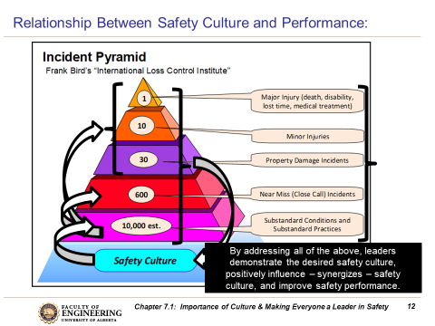
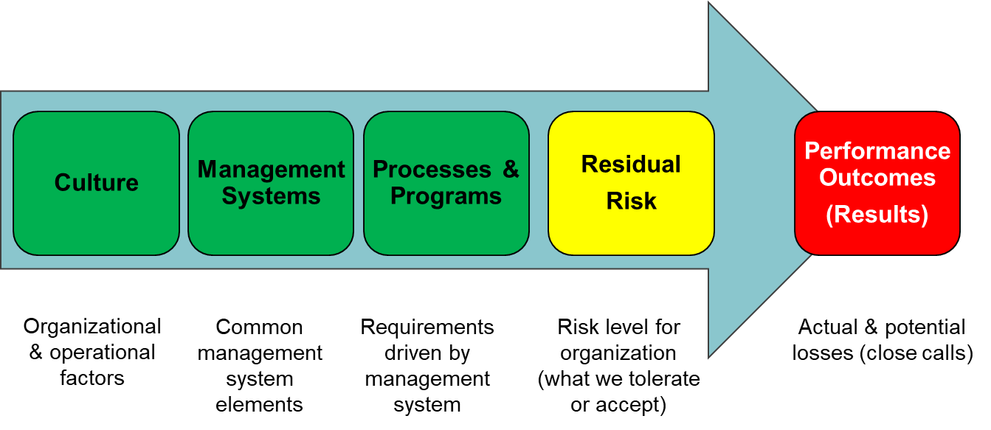
Leadership Actions Determines Safety Culture:
Recall that safety culture determines safety performance:
Q: So, how does leadership shape
that culture?
A: Through their actions!
Just as performance is founded on
culture, culture is founded on
leadership actions.
Let’s explore leadership actions.
Performance
Culture
Leadership Actions
Chapter 7.5: The Importance of Leadership and Links
‹#›
Notes:
‹#›

Slide 7
Leadership Actions Determines Safety Culture:
Five key factors for sound leadership in risk management:
Management belief that “safety is a value”.
Management sets clear expectations.
Management is fully committed and is seen to be committed
i.e. management is visible.
Management’s actions are always consistent with words.
Management views this as a proactive, long-term undertaking that requires constant attention.
Q: So how do leader put these factors into practice?
A: Through their actions.
Chapter 7.5: The Importance of Leadership and Links
‹#›
Notes:
‹#›

Slide 8
Leaders Shape Corporate Safety Culture – Tone at the Top:
Setting the “Tone at the Top”- an example:
Video: Rex Tillerson, Exxon-Mobil CEO,
addresses employees at a Technology Conference,
November 3, 2010; 0:00 – 3:05
Chapter 7.5: The Importance of Leadership and Links
‹#›
Notes:
‹#›

Slide 9

Leaders Shape Safety Culture Through Their Actions:
“Actions Speak Louder than Words”:
Although Leaders set expectations through communications
(e.g. the “Tone at the Top”), the leader’s actions are the strongest form of messaging.
Ultimately, the actions of the
leaders in an organization
define / shape / influence /
create the culture.
  Leadership actions (their behaviours
  in their leadership position) must be
  consistent with communicated
  expectations …
  “Lead by example!” and “Walk the talk”.
Chapter 7.5: The Importance of Leadership and Links
‹#›
Notes:
‹#›

Slide 10
Example: Actions Speak Louder Than Words:
Q: How do managers and leaders influence culture?
Consider the possible decision pathways:
A: Lead by good example: “by the way I do work around here.”
(Read the notes page for this slide.)
ADMINISTRATIVE CONTROLS
NO
Does the Leader follow the AC’s, and coach workers to follow the AC’s?
YES
“The way we do work around here”, but it is NOT a positive culture. The leader has allowed adherence to AC’s to “slide” i.e. complacency sets in.
“The way we do work around here”, but it IS a positive culture. The leader checks adherence to AC’s and acts on deficiencies i.e. combats complacency.
Undesirable: The leader has set the
WRONG example.
Substandard Practices!
Desirable: The leader has set the
RIGHT example.
Acceptable Practices!
Chapter 7.5: The Importance of Leadership and Links
‹#›
Notes:
‹#›
Let’s examine a possible decision pathway that a leader faces. The organization has a set of administrative controls; these document the most effective way, the efficient way to do work with acceptable level of risk to do work. The leader can choose to either: a) disregard these administrative controls in terms of not following them or not insisting that the workers follow them, or b) accept these administrative controls, follow them, and insist that the workers follow and comply with them.
The “YES” pathway results in a positive culture, the “NO” pathway results in a negative culture. In both cases, the leader set the example; therefore it is of utmost importance for leader to “lead by example”, the right example in order for the organization to be successful.

Slide 11
Example: Actions Speak Louder Than Words:
Q: How do managers and leaders influence culture?
Consider the possible decision pathways:
A: Lead by good example: “by the way I do work around here.”
(Read the notes page for this slide.)
ENGINEERING CONTROLS
NO
Does the Leader address deficiencies in EC’s in a timely manner?
YES
“The way we do work around here”, but it is NOT a positive culture. The leader has allowed the condition of EC’s to degrade i.e. complacency sets in.
“The way we do work around here”, but it IS a positive culture. The leader checks that EC’s are sound, and addresses deficiencies i.e. combats complacency.
Undesirable: The leader has set the
WRONG example.
Substandard Conditions!
Desirable: The leader has set the
RIGHT example.
Acceptable Conditions!
Chapter 7.5: The Importance of Leadership and Links
‹#›
Notes:
‹#›
Let’s examine a possible decision pathway that a leader faces. The organization has a number of engineering controls installed in the facility. These engineering controls manage hazards and risks associated with the operations of the facility. The leader can choose to either: a) allow the engineering controls to degrade (deteriorate, fall into a state of disrepair) or b) actively check / inspect, maintain, and repair the engineering controls to ensure that the hazards and risks are being controlled to an acceptable level, per the design intent of the engineering controls.
The “YES” pathway results in a positive culture, the “NO” pathway results in a negative culture. In both cases, the leader set the example; therefore it is of utmost importance for leader to “lead by example”, the right example in order for the organization to be successful.

Slide 12
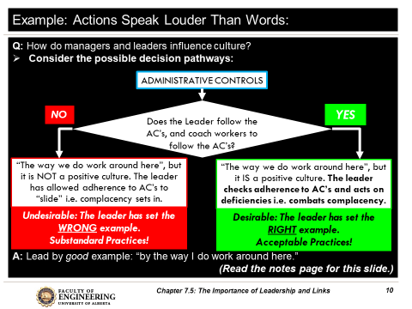
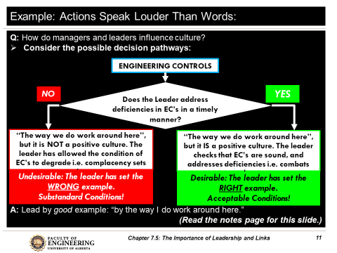
“Actions Speak Louder than Words”:
The actions of the leader will directly influence the culture of the organization.
Good Leaders (and good managers) influence the culture in a desirable manner directly through their positive actions: “Walk the Talk!”
Any negative action can undermine and degrade the desired culture.
“Do as I say, not as I do” is NEVER acceptable for a leader!
Chapter 7.5: The Importance of Leadership and Links
‹#›
Notes:
‹#›

Slide 13
ALE #1: Leadership Actions on SC’s and SP’s
Please confer and respond (pen-to-paper, MM-Poll):
You observe these sub-standard conditions and sub-standard practices:
  Oil spill on floor.
  A worker is not wearing required eye protection in the shop.
  A worker is not wearing fall protection when at elevation.
  The PTW practices are sub-standard in one of your operations.
Your actions as seen by others will influence their actions and ultimately will shape the culture.
What happens if you take no action (to clean up the spill, and so on)?
  The likelihood of an incident happening is not related to any actions you take as a leader.
  The management of risks will break down and eventually a loss incident will happen.
  Risk levels don’t change even though control measures break down.
Chapter 7.5: The Importance of Leadership and Links
‹#›
Notes:
‹#›

Slide 14
Leadership Action: Sub-standard Conditions and Practices:
You observe these sub-standard conditions and sub-standard practices:
  Oil spill on floor.
  A worker is not wearing required eye protection in the shop.
  A worker is not wearing fall protection when at elevation.
  The PTW practices are sub-standard in one of your operations.
Your actions as seen by others will influence their actions and ultimately will shape the culture.
If you take no action on any of the previously stated SC’s and SP’s:
  Workers will not attend to and correct SC’s and SP’s.
  Workers will become complacent in all areas of managing risks.
  The control of hazards and the management of risks will break down.
  Eventually a loss incident will happen.
Therefore, as a Leader in Risk Management, and wanting to
“lead by example” or “walk the talk”, you must:
  Set in place a (temporary) barricade and arrange for clean-up the oil spill.
  Stop the worker; discuss their lack of eye protection.
  Stop the worker and ask them to come down.
  Initiate a strategy (take action) to improve the PTW practices.
  These leadership actions - correct SP’s and SC’s, combat complacency, maintain risk control measures – shape the culture and ultimately prevent loss incidents!
Chapter 7.5: The Importance of Leadership and Links
‹#›
Notes:
‹#›

Slide 15
Leaders Need to Be Smart About Managing Risks:
Can a leader address every sub-standard condition and practice?
Recall these:
  Oil spill on floor.
  A worker is not wearing required eye protection in the shop.
  A worker is not wearing fall protection when at elevation.
  The PTW practices are sub-standard in one of your operations.
Previous leadership practices had us striving to intervene on and address all of these.
Is this sustainable? Let’s examine this:
  By reviewing:
  Alberta Workplace Injuries & Disease Rates (2009 to 2018)
  Alberta Occupational Fatalities (2009 to 2018)
  Injury Rate Trends in Other Jurisdictions:
  Heinrich Safety Triangle
  High Potential (HiPo) Incidents Model:
  And by examining on which events leaders should focus.
Chapter 7.5: The Importance of Leadership and Links
‹#›
Notes:
‹#›

Slide 16
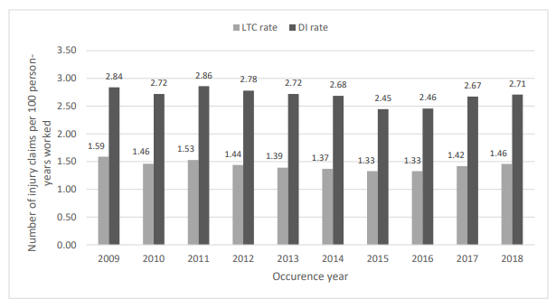
Alberta Workplace Injuries & Disease Rates (2009 to 2018)
Two measures used by the Alberta Government for workplace injury and disease risks are LTC (lost time cases) and DI (disabling injury) rates. DIs include LTCs and modified-work claims
Compared to 2009, the LTC rate decreased 8.2 per cent (1.59 in 2009 versus 1.46 in 2018); and the DI rate decreased 4.6 per cent (2.84 in 2009 versus 2.71 in 2018).
Other organizations report similar improvements in both trends, some at even greater improvements e.g. from LTC/DI = 2.5 in 1999 to LTC/DI = 0.25 in 2020 (a factor of 10X improvement)
Chapter 7.5: The Importance of Leadership and Links
‹#›
Notes:
‹#›
Two basic measures of workplace injury and disease risks are LTC and DI rates.
These rates represent the number of injury or disease claims per 100 person-years worked.
DIs include LTCs and modified-work claims. The LTC rate of Alberta workplaces increased from 1.42 in 2017 to 1.46 in 2018. The DI rate increased from 2.67 in 2017 to 2.71 in 2018. Compared to 2009, the current LTC rate decreased 8.2 per cent (1.59 in 2009 versus 1.46 in 2018); and the DI rate decreased 4.6 per cent (2.84 in 2009 versus 2.71 in 2018).
Several factors can contribute to changes in LTC and DI rates, including but not limited to:
changes in workplace health and safety culture
enhanced OHS compliance
improved support for modified-work arrangements
industry-led initiatives to improve workers’ health and safety

Slide 17
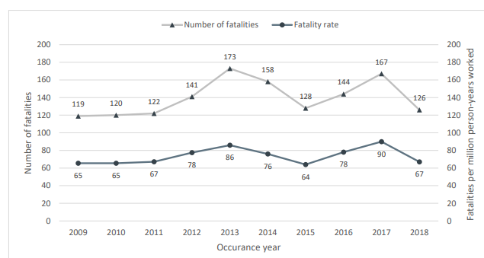
Alberta Occupational Fatalities (2009 to 2018)
The 2018 fatality rate was up slightly from 2009 (67 in 2018 versus 65 in 2009)
The Alberta workplace fatality rate ranges between 64 (low) and 90 (high)
Unlike LTC & DI rates, why have we not seen a decrease in the Alberta workplace fatality rate from 2009 to 2018?
Similarly, some leading organizations have seen LTC/DI improvements of 10X yet have essentially the same fatality rate.
Chapter 7.5: The Importance of Leadership and Links
‹#›
Notes:
‹#›
In 2018, the number of occupational fatalities was 126, down 24.6 per cent from 167 in 2017. The fatality rate is the number of fatalities per million person-years worked. The fatality rate decreased from 90 in 2017 to 67 in 2018.
Occupational fatalities are classified into three general types: motor vehicle incidents, workplace incidents and occupational disease.
The proportion of fatalities by type in 2018 was:
Occupational diseases – 45.2%
Motor vehicle incidents – 21.4 %
Workplace incidents – 33.3 %

Slide 18
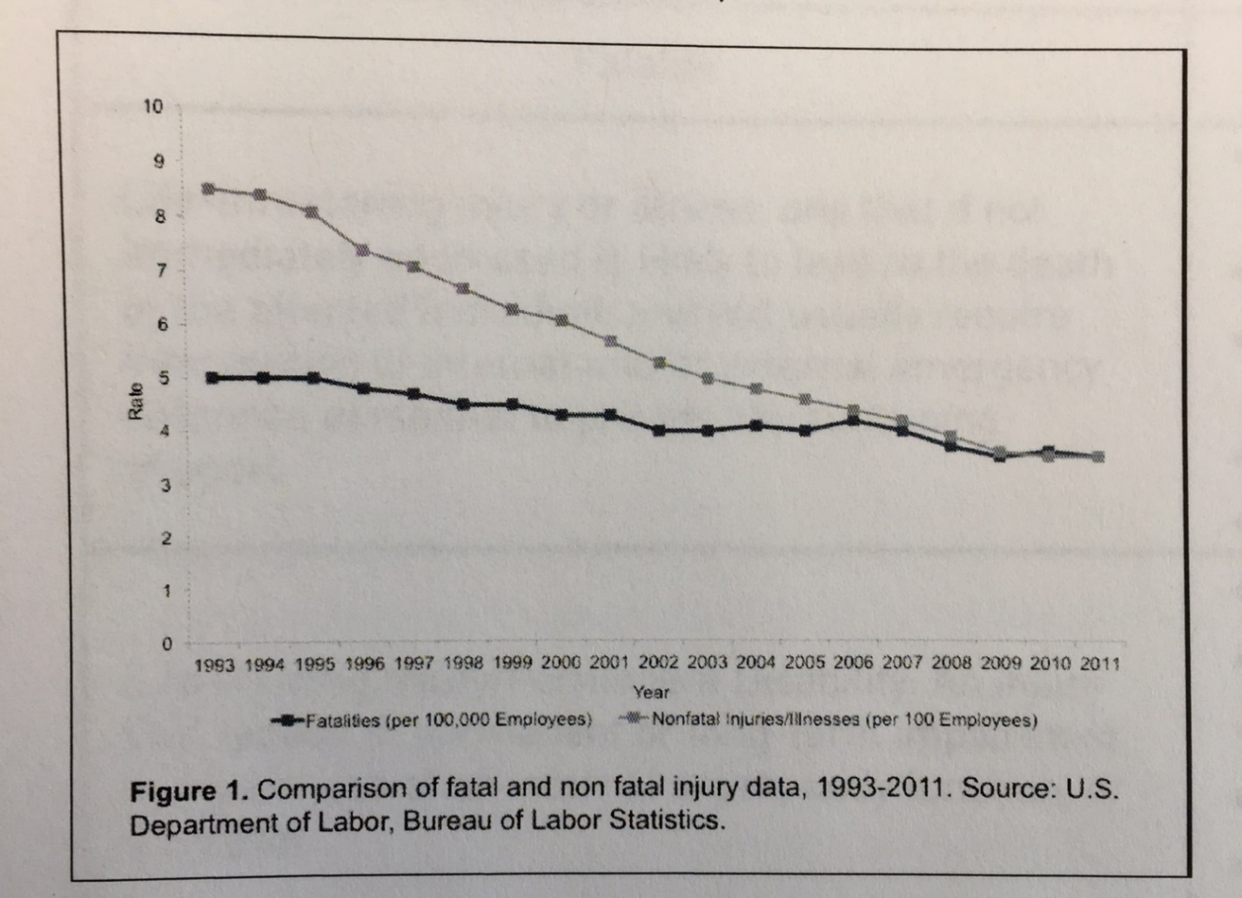
Injury Rate Trends in Other Jurisdictions:
This is seen in many different jurisdictions!
The injury rate is declining (a good thing) whereas the fatality rate is not declining at the same rate.
Injuries
Fatalities
Chapter 7.5: The Importance of Leadership and Links
‹#›
Notes:
‹#›

Slide 19
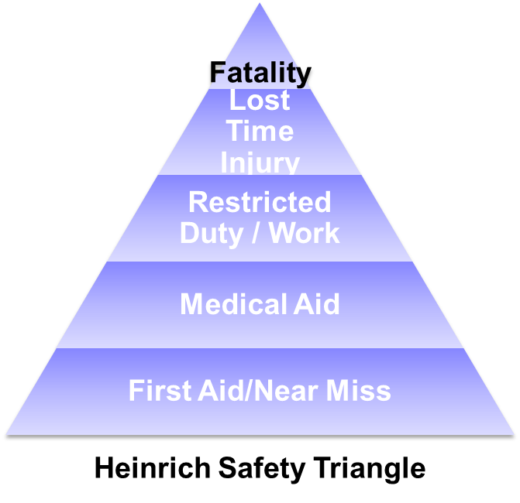
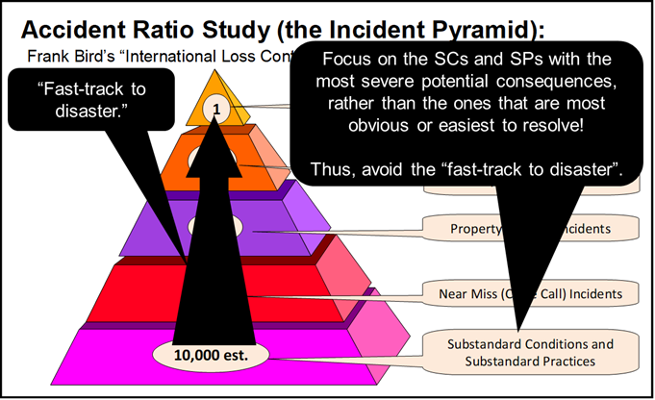
Compare Two Incidents Model:
Compare - Bird Study with the Heinrich Safety Triangle (see notes):
Chapter 7.5: The Importance of Leadership and Links
‹#›
Notes:
‹#›
These two models are similar – increasing severity with fewer “counts” as one moves up. As was identified in the topic Chapter 6.2: Safety Metrics,
Lagging and Leading Indicators, some sub-standard conditions and some standard practices are the “fast track to disaster”.

Slide 20
Heinrich Safety Triangle:
Incorrect Assumptions:
As injuries increase in severity there is a
decrease in frequency.
All low severity injuries have the same
potential for serious injury.
Injuries of differing severity have the
same underlying root causes.
Reducing less serious injuries will
also reduce more serious injuries
i.e. the ratios stay the same.
These incorrect assumptions also hold for the Bird Incident Ratio Study. These are NOT prediction models!
Fatality
Lost Time Injury
Restricted Duty / Work
Medical Aid
First Aid/Near Miss
Heinrich Safety Triangle
Chapter 7.5: The Importance of Leadership and Links
‹#›
Notes:
‹#›

Slide 21
A New Paradigm – High Potential (HiPo) Incidents Model:
The next evolution in applying this model concept (Bird or Heinrich)…
Examine actual outcomes and potential outcomes:
Within the layer, each star represents a lost time incident (actual outcome)
We identify a sub-set of incidents (grey area) that, if not for luck,
had the potential for a more severe outcome (fatality)
HiPo incidents
Chapter 7.5: The Importance of Leadership and Links
‹#›
Notes:
‹#›
Within each layer, some of those incidents have the potential to become fatalities. As a leader, you need to pay attention to the HiPo incidents.

Slide 22
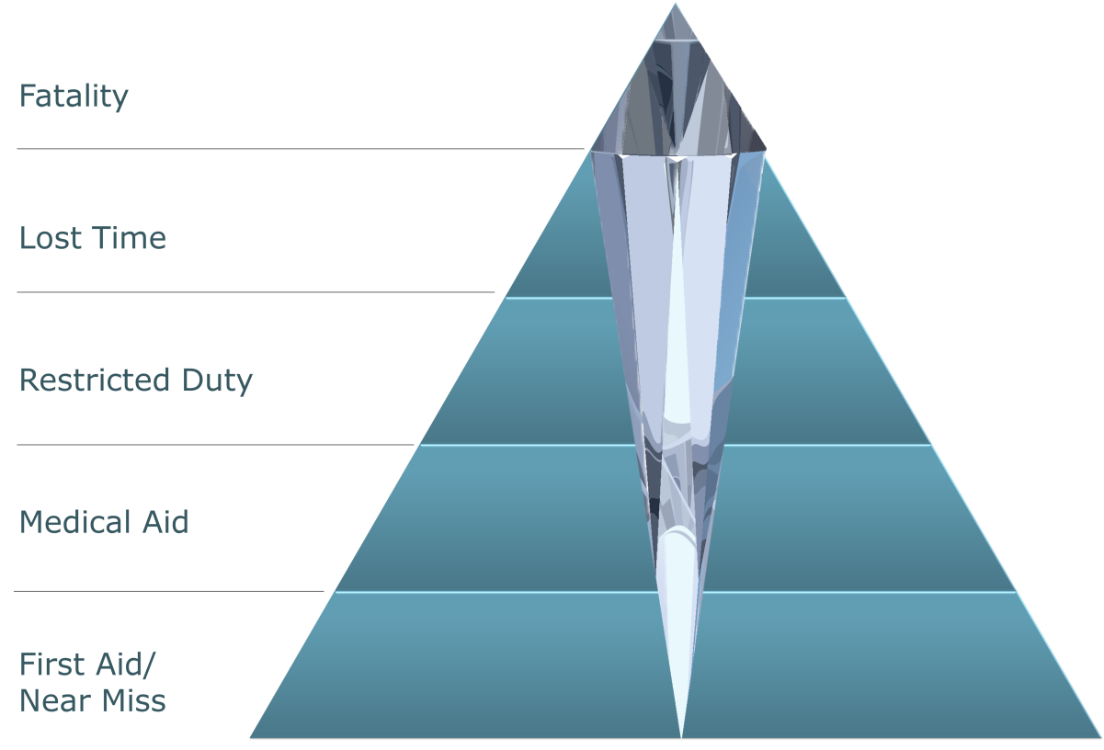
HiPo Model - “A Diamond Within The Triangle”:
The “HiPo” Incident Model and the “Diamond Within the Triangle”:
A subset of the incident triangle data – those critical practices and conditions that are substandard, and near miss events – has the potential for a more severe outcomes i.e. “High Potential Events” for both occupational safety and technical safety.
This demands the attention of the organization to:
  Efficiently prioritize issues
  and allocate limited resources
  to address deficiencies in
  conditions and practices with
  higher-than-acceptable risk
  levels.
  Influence the culture of an
  organization by directing
  focused activities on key
  metrics i.e. the “HiPo” events.
Chapter 7.5: The Importance of Leadership and Links
‹#›
Notes:
‹#›
In other words, there will be relatively few – a low number – of near miss incidents, sub-standard practices, and sub-standard conditions that have the potential to become a fatality. As each layer is examined, there will be relatively more as you move up the pyramid i.e.
more LTIs that have the potential to become a fatality.

Slide 23
“HiPo Model” - “A Diamond Within The Triangle”:
Analyse the data to “find the diamond”:
By examining each layer in the incident triangle for potential serious incidents / fatalities, we develop the “diamond” within the triangle.
Common characteristics of “diamond” incidents:
    Unusual and non-routine work
    Sources of high energy are present
    Construction
    (Sub) Contractors
Then we can prioritize
our efforts to address the
potential incidents with
the highest potential for
severe consequences!
Chapter 7.5: The Importance of Leadership and Links
‹#›
Notes:
‹#›
In other words, there will be relatively few – a low number – of near miss incidents, sub-standard practices, and sub-standard conditions that have the potential to become a fatality. As each layer is examined, there will be relatively more as you move up the pyramid i.e.
more LTIs that have the potential to become a fatality.

Slide 24
ALE #2: Sub-standard Conditions & Practices for HiPo Events:
Please confer and respond (MM-Poll):
Consider that there is difference between some kinds of SC’s & SP’s and other kinds of SC’s and SP’s. Consider these comparative situations where you see someone:
Walking by an oil spill vs. working in an excavation with no shoring.
Not wearing eye protection in the chemical plant vs.
not wearing fall protection when working at elevation.
Pressure gauge for indication purposes is found out-of-calibration by 10% vs over-pressure safety relief valve is found defective
  For each of these comparative situations, which one you would address first? Why?
  “oil spill vs. excavation shoring”
  “no eye protection vs. no fall protection”
  “out-of-cal pressure gauge or defective over-pressure relief valve”
Chapter 7.5: The Importance of Leadership and Links
‹#›
Notes:
‹#›

Slide 25
Ex: Sub-standard Conditions & Practices for HiPo Events:
Which of these comparative situations would you address first based on consequence, especially when likelihood is similar?
a) 1st: Working in an excavation with no shoring:
engulfment and fatality!
2nd: Walking by an oil spill on floor:
worse case injury is a joint injury or fracture
b) 1st: Not wearing fall protection:
permanently disabling injury or fatality
2nd: Not wearing eye protection:
infection, minor injury, remote likelihood of loss of sight
c) 1st: Defective PRV:
over-pressure condition in vessel and rupture
2nd: Out-of-cal pressure gauge:
inefficient operation
Chapter 7.5: The Importance of Leadership and Links
‹#›
Notes:
‹#›

Slide 26
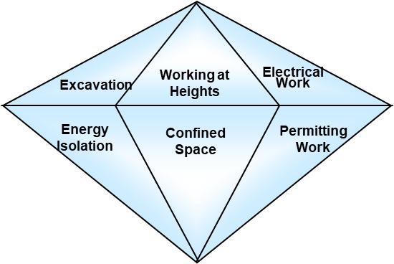

HiPo Critical Occupational Activities Require Life-Saving Rules:
Critical Occupational Activities:
  Those few sets of occupational activities
  where one error, one mistake, one
  mis-step could result in a serious
  (permanent, disabling) injury or
  a fatality.
Life-Saving Rules:
“Life saving rules” are administrative
controls, and go by many different names
e.g. life-essential rules, life-critical standards.
These rules define the critical control measures and
practices that must be followed in order to manage
the risks to an acceptable level, and to complete
the job without any negative impact.
If there are any deviations from the critical control
measures and practices, the likelihood of a loss incident
increases significantly and is likely to result in a serious injury or fatality.
Deviations cannot be tolerated!
Chapter 7.5: The Importance of Leadership and Links
‹#›
Notes:
‹#›

Slide 27
Critical Occupational Activity with HiPo: Excavation Activities
Excavation:
Excavation
Working at Heights
Electrical
Work
Energy Isolation
Confined Space
Permitting Work
Potential Risk Exposures
Energized Lines
Buried utilities
Collapse/Engulfment
Flooding
Worker/Machine Interface
Access/Egress
Operator Error
Barriers/Protection
Safeguards
  First Call (dial before you dig)
  As built/red line drawings
  Excavation procedures
  Work site inspections
  Task observation program
  Risk Assessments
  JSA and pre-task planning
  Training
Chapter 7.5: The Importance of Leadership and Links
‹#›
Notes:
‹#›

Slide 28
Critical Occupational Activity with HiPo: Working at Height
Working at Height:
Excavation
Working at Height
Electrical
Work
Energy Isolation
Confined Space
Permitting Work
Potential Risk Exposures
Fall to lower level
Falling (dropped) Objects
Improper Scaffolding
Defective or improperly worn PPE: Tie off, lanyards and harnesses
Inadequate Access / Egress
Worker / Machine Interface
Equipment failure
Safeguards
  Working at Height: policy, program, procedures, checklists
  Physical Barriers (Guardrails)
  Housekeeping at Elevations
  Work site inspections & audits
  Task observation program
  Training and Certification
  Risk Assessments
  JSA and Pre-Job Planning
Chapter 7.5: The Importance of Leadership and Links
‹#›
Notes:
‹#›

Slide 29
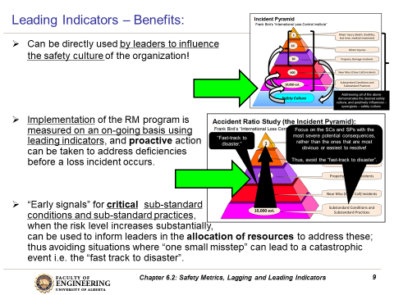
How to Use “HiPo” Leading Indicators to Influence Culture:
Look for “signals” …
Recall discussion on Leading Indicators from Chapter 6.2: Safety Metrics:
Chapter 7.5: The Importance of Leadership and Links
‹#›
Notes:
‹#›

Slide 30
ALE #3: Use “HiPo” Leading Indicators to Influence Culture
Please confer (pen-to-paper, open discussion):
Consider this leading indicator:
Fraction of all reported sub-standard conditions and sub-standard practices that were considered “HiPo” (high potential).
Example: In the weekly Maintenance Team Meeting, there were a total of 268 SC’s and SP’s observed and reported in the prior week.
Of those, 6 were deemed as “HiPo”:
Three (3) concern moving heavy equipment into position where the equipment operator continued to back-up when the “spotter” was not visible in the mirrors, a critical work practice (an administrative control was not being followed)
Three (3) concern imminent failure in critical equipment monitoring systems (an engineering control was defective)
Obviously, you have limited resources and cannot work on all 268 items; thus, you should focus your efforts (allocate your limited resources) on heavy equipment movement and the imminent failure of critical equipment.
So, what actions would you take to reduce risks on these HiPo events?
By way of these actions, you positively influence safety culture!
Chapter 7.5: The Importance of Leadership and Links
‹#›
Notes:
‹#›

Slide 31
Example: Use “HiPo” Leading Indicators to Influence Culture
Consider this leading indicator: the fraction of all reported sub-standard conditions and sub-standard practices that were considered “HiPo” (high potential).
Example: In the weekly Maintenance Team Meeting, there were a total of 268 SC’s and SP’s observed and reported in the prior week. Of those, 6 were deemed as “HiPo”: 3 concerning moving heavy equipment into position where the equipment operator continued to back-up when the “spotter” was not visible in the mirrors, a critical work practice (an administrative control was not being followed) and 3 concerning imminent failure in critical equipment monitoring systems (an engineering control was defective).
These data can be used to efficiently allocate limited resources (focus your efforts) to address critical SP’s and SC’s, and positively influence safety culture with these actions:
  Heavy Equipment Movement: Provide highlight training on using the company’s “Vehicle Driver / Spotter FLRA” in the daily tail-gate meetings; increase manager inspections of the use of the FLRA and the critical practices for heavy equipment movements.
  Imminent Failure: Assess maintenance resources for addressing the backlog of critical equipment monitoring systems, raise priority on repair.
  All other non-HiPo SC’s and SP’s may or may not be addressed!
  Management action not only addresses HiPo SC’s and SP’s, but also demonstrates management commitment - “walk the talk”, “lead by example”.
Chapter 7.5: The Importance of Leadership and Links
‹#›
Notes:
‹#›

Slide 32
ALE #4: Leading Indicators for Technical Safety in your Field?
Please confer (pen-to-paper, open discussion):
What would be some Leading Indicators for Technical Safety in your field of study and design expertise?
Aerospace
Chemical
Civil
Computer Science
Electrical
Electronics
Materials
Management / Industrial
Mechanical
Mining
Petroleum
Process Control
Nano-engineering
One way to approach this: What is a catastrophic event, and what could you measure that is intended to prevent such a catastrophic event?
Chapter 7.5: The Importance of Leadership and Links
‹#›
Notes:
‹#›

Slide 33
Not Just the Typical Occupational or Process Safety “HiPo’s”:
High Potential Impact Events in Cyber Security:
Comparative situation:
  Network firewall is disabled on financial database (bank account numbers, access codes, SIN, etc.) vs
  Network firewall is disabled on email database (username, email address, and phone number)?
The first situation can result in greater harm (greater impacts on PEAP) and therefore requires action before acting on the second situation:
  Disabled firewall on financial database: ransom, identity theft of clients, damage to reputation to company, restitution to clients
  Disabled firewall email database: inconvenience / nuisance to change password on or username and address, although potential for future phishing attacks
  Bonus discussion point: What are the “early signals”?
Chapter 7.5: The Importance of Leadership and Links
‹#›
Notes:
‹#›

Slide 34
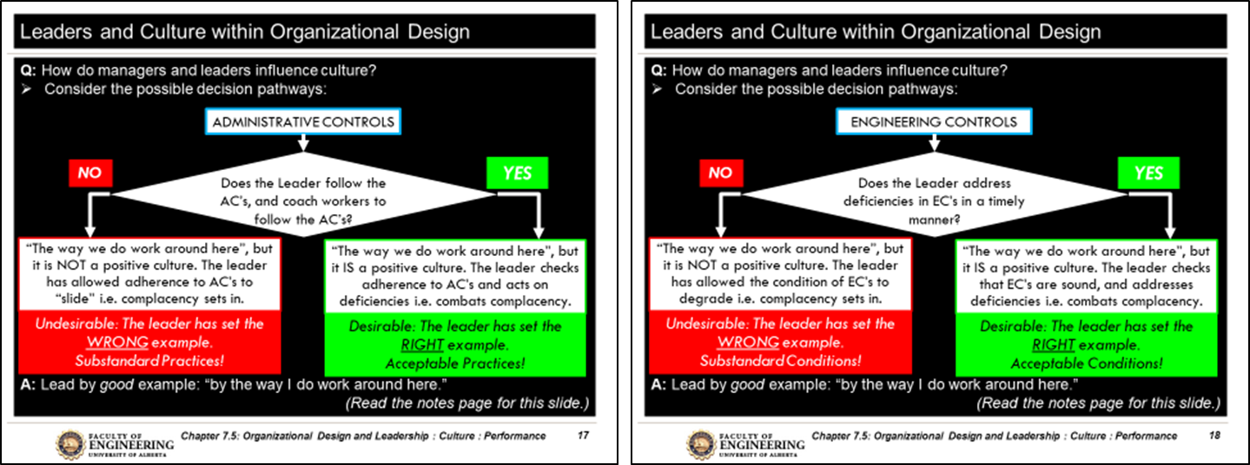

Relationship: Leadership Actions, Culture, and Performance:
This depiction illustrates the relationship between:
leadership actions in addressing HiPo events and culture,
culture and performance.
Performance
Culture
Leadership Actions
Chapter 7.5: The Importance of Leadership and Links
‹#›
Notes:
‹#›

Slide 35
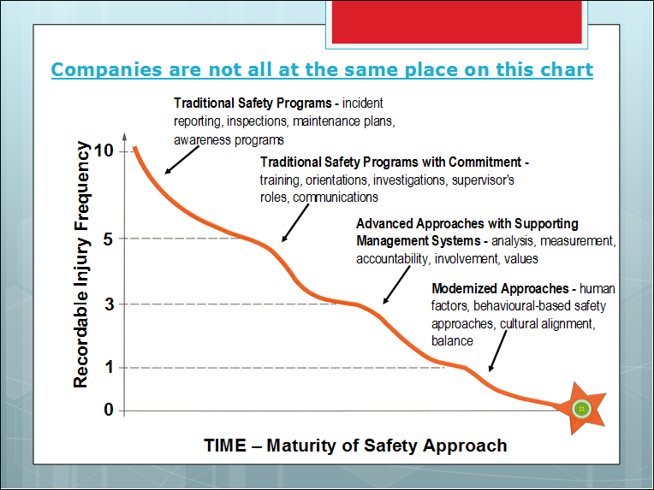

Performance in Response to the Evolution of Culture:
Performance improves in response to the evolution (sequential and layering) of the organization’s safety approaches i.e. its safety culture:
From prescribed
and leader-directed
at the left side,
Through building
commitment and
involvement,
To advanced and
modernized
approaches to engage
and empower workers
in reaching and
sustaining the
desired culture.
Modernized Approaches:
human factors, behavioral-based safety approaches, engagement, cultural alignment, balance, influencing human behaviours
Target: Zero
Chapter 7.5: The Importance of Leadership and Links
‹#›
Notes:
‹#›
Performance in Response to the Evolution of Culture:
5) Adapting - safety is a core value of the organization and a primary driver for successful enterprise.
4) performance monitoring using statistics to drive continuous improvement.
3) management systems based such as Job Safety Assessment (JSA), Isolation and Lock-out, etc.
2) Complying to rules and regulations.
1) Reacting to incidents as they occur.
0) No safety program - maybe even disdain for safety.
Need to work from bottom up, can’t leapfrog.
Rules and regulations do not make a safety program, only at level 2.
Industry needs students prepared to work at level 5.
Most universities are probably sending out students at level 2.

Slide 36
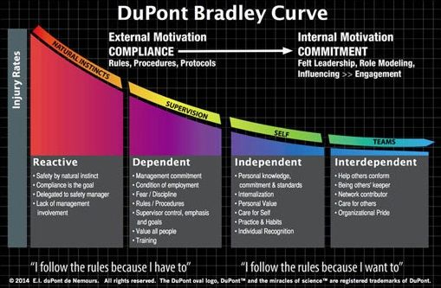
Organizational Analysis and The DuPont-Bradley Curve:
A method to benchmark progress toward an ideal safety culture
Injury rates (losses) fall as you proceed through the phases
Video 1:35 m:ss DuPont-Bradley Curve: https://www.consultdss.com/bradley-curve-video/
The DuPont-Bradley Curve and the Four Different Phases of Cultural Development
Chapter 7.5: The Importance of Leadership and Links
‹#›
Notes:
‹#›

Slide 37
The Phases of The DuPont-Bradley Curve:
Phase 1 (Reactive): lowest level; reactive to incidents; reliance on safety manager from the safety department (not the organizational manager e.g. plant manager) to make changes after an incident, OHS regulatory citation or new regulation; workers tend to resist compliance; workers take on (unacceptable) risks; work environment is generally negative with high stress level for workers
Phase 2 (Dependent): slightly better with good training & safety rules; fewer losses but stress can still be high; workers comply because they feel have to, not because they want to; put safety manager in role of “the safety cop” who has to check on workers to make sure they are working safely; workers generally comply but still “take short-cuts”; safety manager hired to “fix safety”; safety manager “owns the loss incident”, leads investigation and “owns results”, not the organizational manager i.e. the safety manager is responsible and accountable.
Chapter 7.5: The Importance of Leadership and Links
‹#›
Notes:
‹#›

Slide 38
The Phases of The DuPont-Bradley Curve:
Phase 3 (Independent): even better; workplace is proactive; workers have internalized safety requirements, and understand why they are important & know their efforts will be recognized; culture still has room to improve as workers tend to focus more on looking out for themselves; workers begin to stop taking unacceptable risks; evolution of transfer of ownership of loss incidents and investigations from the safety manager to the organizational manager.
Phase 4 (Interdependent): gold standard; workers are proactive & engaged; workers take pride in their work & safety record; they do not hesitate to look out for each other & remind fellow workers if they see them cutting safety corners; workers “own their safety”, do not take unacceptable risks i.e. they stop; transfer of ownership is complete – organizational manager own the loss incident, the investigation, and the results i.e. the organizational manager.
Chapter 7.5: The Importance of Leadership and Links
‹#›
Notes:
‹#›

Slide 39
How to Apply The DuPont-Bradley Curve:
Our Tenet: Culture drives performance!
So, to improve performance, leaders need to influence culture.
  Many organizations think they are well developed into Phase 3, even Phase 4, but in reality the organization is not there.
  As a leader you need to know where your organization is i.e. in which phase of the Bradley Curve is your organization?
  An organization can be analyzed to determine its development along The D-B Curve:
  You can determine which phase by analysing your organization:
  Compare characteristics of each phase in the D-B Curve with the characteristics in your organization.
  Compare the implementation of various risk management system elements and programs. For example on RME #5 IRIAA:
  Advanced safety cultures are proactive e.g. reporting and investigating near miss events with high potential; whereas
  Cultures at a lower-phase of maturity have more of a reactive approach
  e.g. reporting only the most significant events as required by law, and may not even be investigation those events.
This same approach can be done on any other RM element and program.
Chapter 7.5: The Importance of Leadership and Links
‹#›
Notes:
‹#›

Slide 40
ALE #5: Apply The DuPont-Bradley Curve to RME #4 MOC
Please confer (pen-to-paper, open discussion):
RME #4 Management of Change:
This element is about “managing change” within the organization. Key points:
A change from what has usually or normally been done or used e.g. procedure, or a change in the organization (people and processes)
“Change” introduces or causes a change in: a) risk level, or
b) the effectiveness in risk control measures, or c) new risks!
Management must clearly communicate the definition of change, and reinforce the processes for managing change.
Using RME #4 MOC as the point for analyzing how an organization has developed along the DuPont-Bradley Curve, what would be some positive or desirable characteristics of an organization in an advanced safety culture (in Phase 4) versus the negative or undesirable characteristics of an organization in an early phase?
Chapter 7.5: The Importance of Leadership and Links
‹#›
Notes:
‹#›

Slide 41
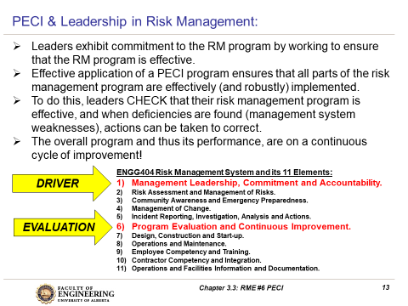
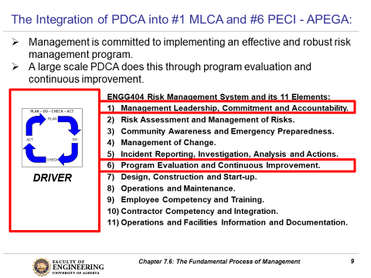
Integration of PDCA, RME #6, PECI, & The Bradley Curve:
The analysis of an organization using the DuPont-Bradley Curve can essentially examine the sub-culture of an organization; for example, how it “does work” relating to any risk management system element.
The obvious goal is to improve – advance along the Curve.
The programs under RME #6 PECI are exactly intended to do this!
And the application of #6 PECI is the application of Plan-Do-Check-Act at the organizational (system / program) level.
Chapter 7.5: The Importance of Leadership and Links
‹#›
Notes:
‹#›

Slide 42

Summary: Leadership, Culture, and Performance
Performance
Culture
Leadership Actions
Chapter 7.5: The Importance of Leadership and Links
‹#›
Notes:
‹#›
Culture eats performance!

Slide 43
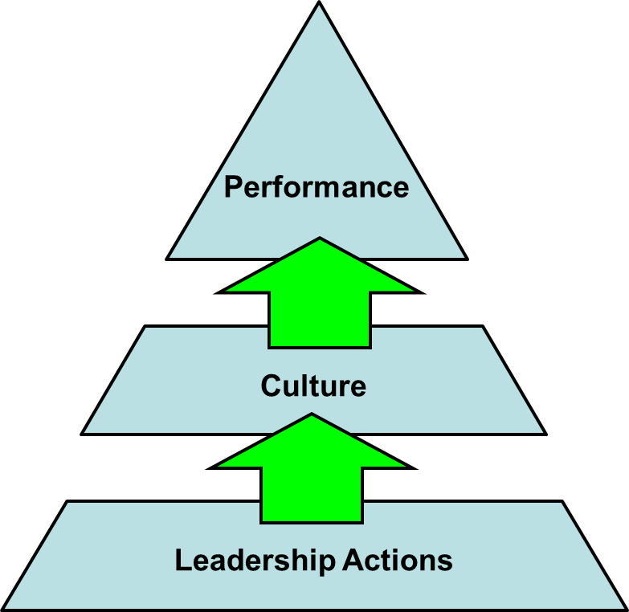
Summary & Key Lesson: “Actions Speak Louder than Words”
Safety performance is determined by the culture of the organization.
  When corporate culture is improved, safety performance improves.
Safety culture is determined by the actions of leaders!
  Leaders set expectations through communication
  and actions (e.g. the “Tone at the Top” … RME #1)
  The leaders actions (practices, behaviours –
  whether positive or negative) are the strongest
  form of messaging.
Leaders can efficiently improve culture, and thereby improve safety performance, by carefully reviewing SC/SP/near miss/incident reports, and screening for those with “HiPo” impacts, and focusing limited intervention resources on these.
Leaders can assess the development of an organization using the integration of PDCA, #6 PECI, and The DuPont-Bradley Curve.
Chapter 7.5: The Importance of Leadership and Links
‹#›
Notes:
‹#›

Slide 44
Any questions?
Notes:
‹#›

